Slide 1
Arduino Sensor Program
Aditya Kesari

Slide 2
Objective
Create a program where a sensor activates if an objective is present at a certain distance.

Slide 3
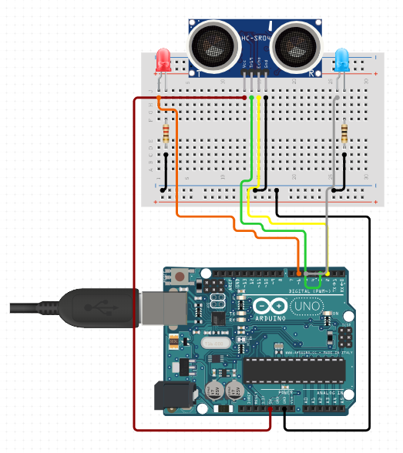
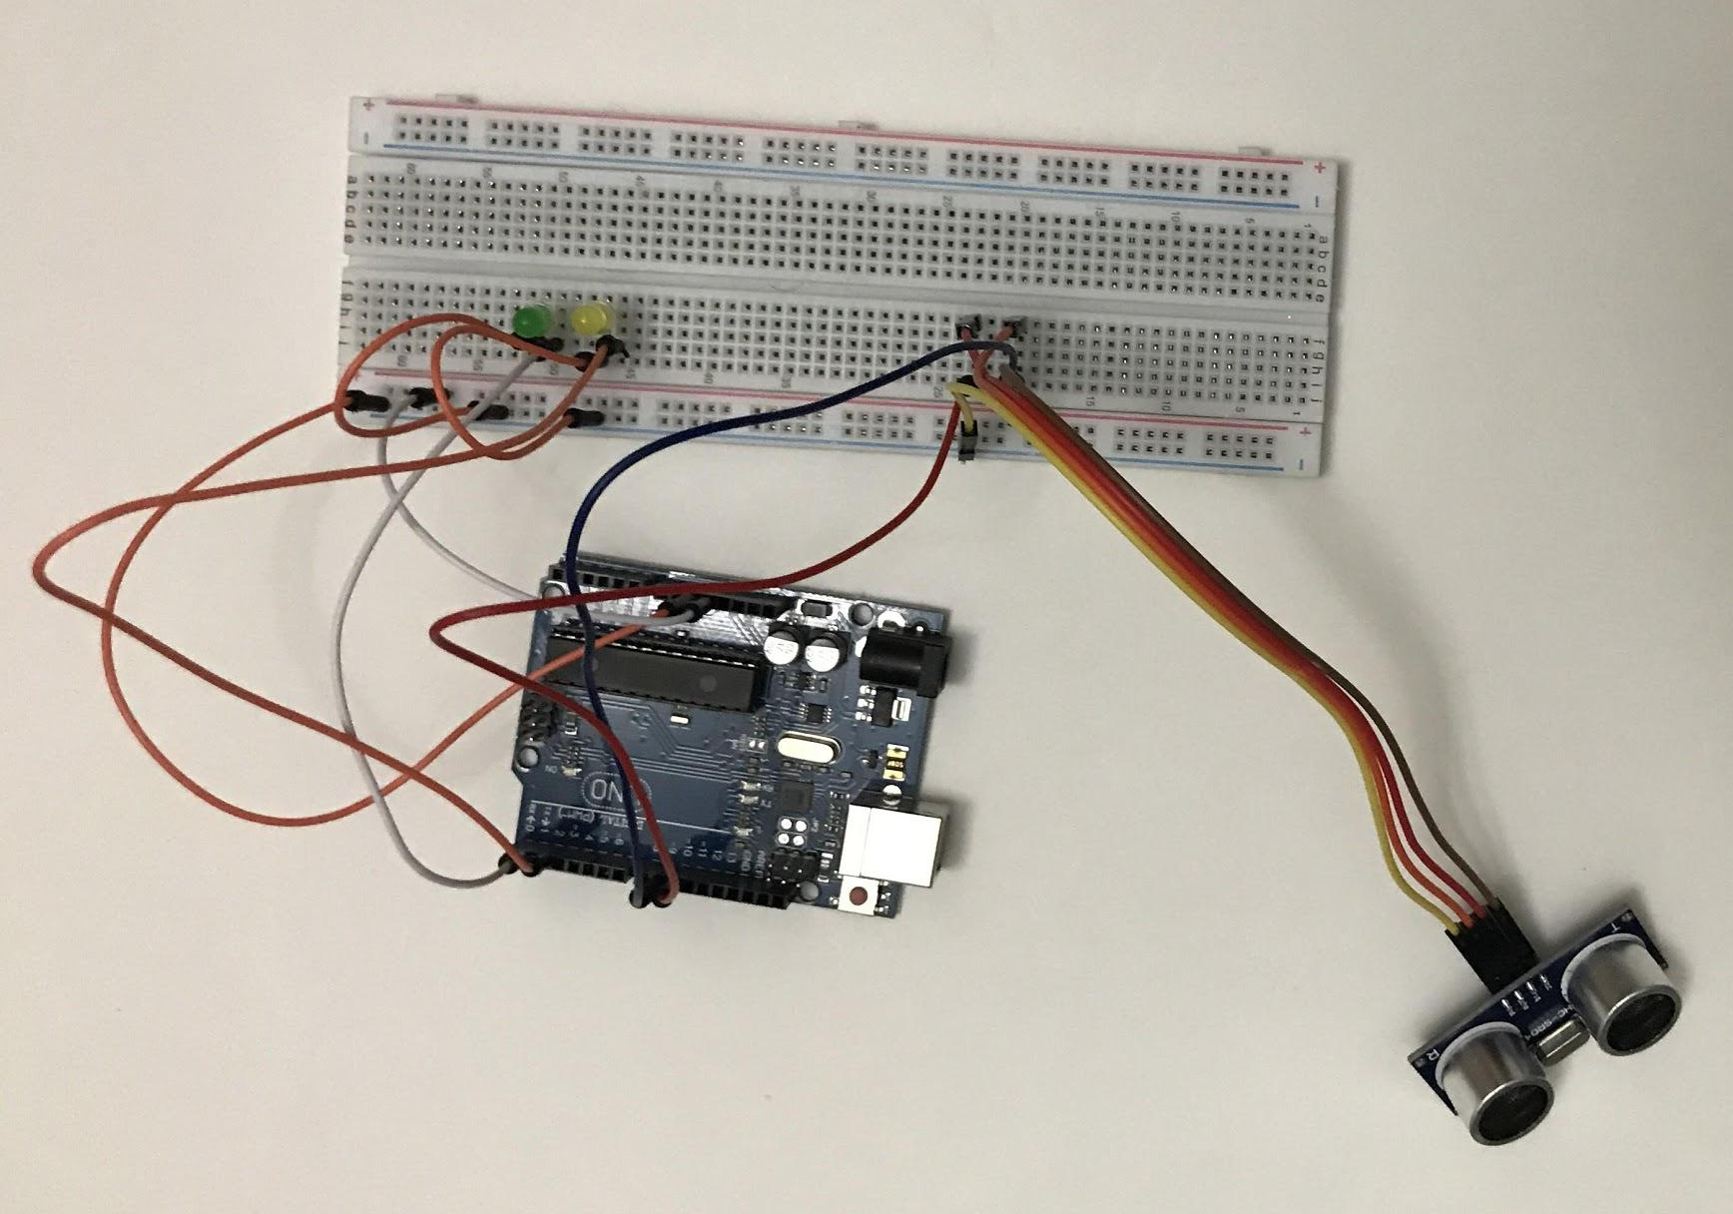
Sensor - Arduino Board
Follow the demonstration carefully!

Slide 4
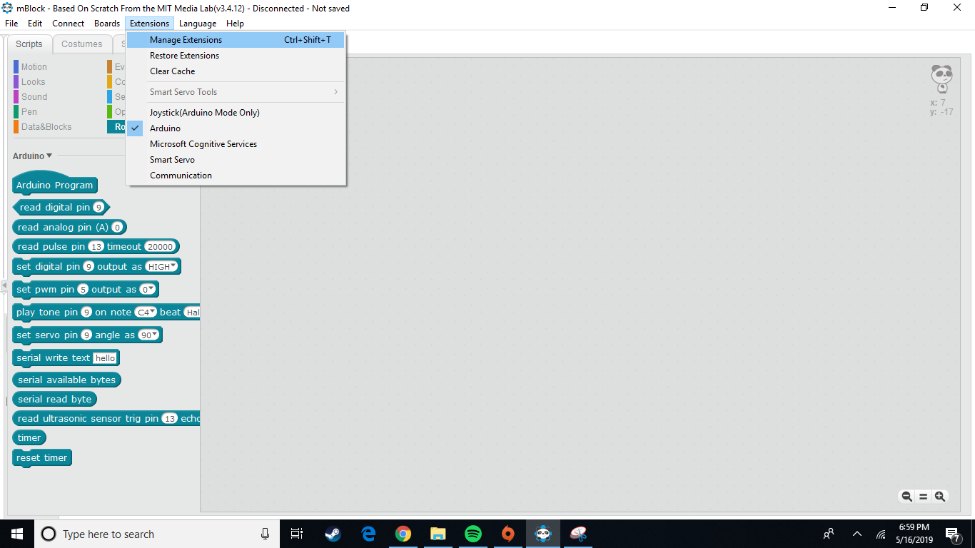
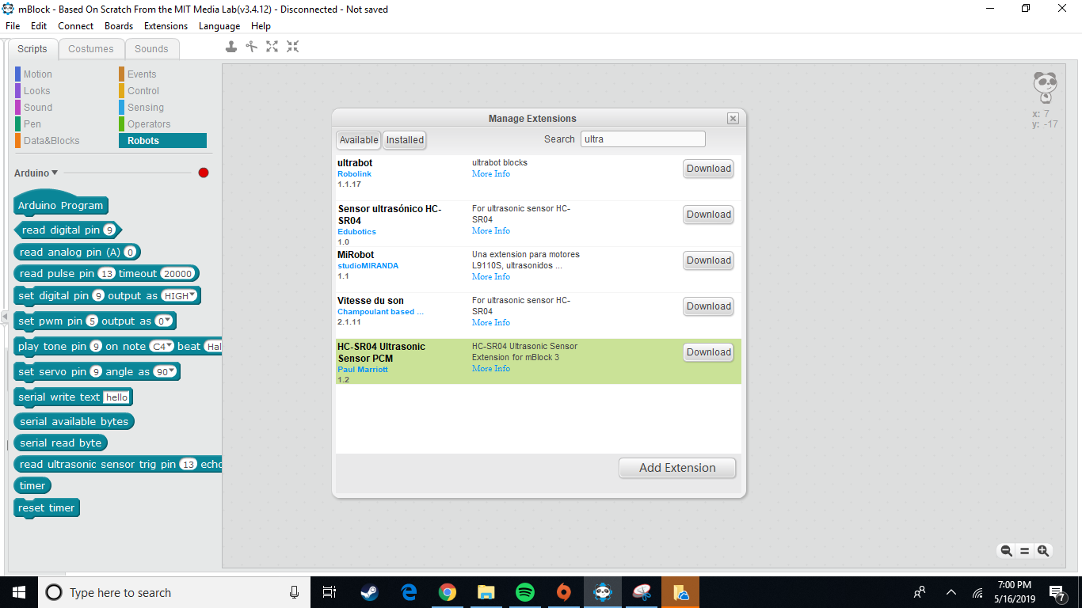
Add HC-SR04 Extensions in mBot ?

Slide 5
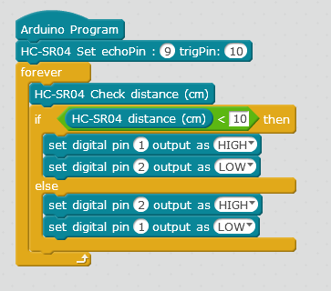
Sensor - Programming
HC-SR04 distance - set how far the sensor notices a change (in cm)
echoPin and trigPin are components of the sensor

Slide 6
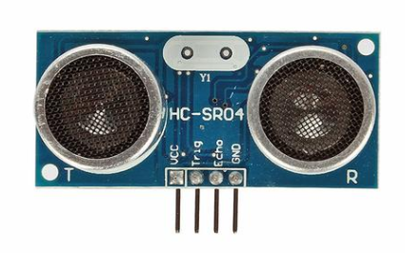
HC SR- 04
This is the HC-SR04 ultrasonic ranging sensor. This economical sensor provides 2cm to 400cm of non-contact measurement
Stable performance, accurate measurement range
Using IO trigger for at least 10us high level signal
Automatically send 8 40KHz, and detect whether there is a signal to return

Slide 7
Sensor Dynamics
Velocity of Speed = 343 meter / sec
If you know the time a sound travels , you can find the distance
Let’s say, time t = 0.0006 sec
Velocity = distance / time
Therefore the distance = 343 X 100 X 0.0006 sec = 20cm

